Slide 1
Athens: Women & Slaves

Slide 2
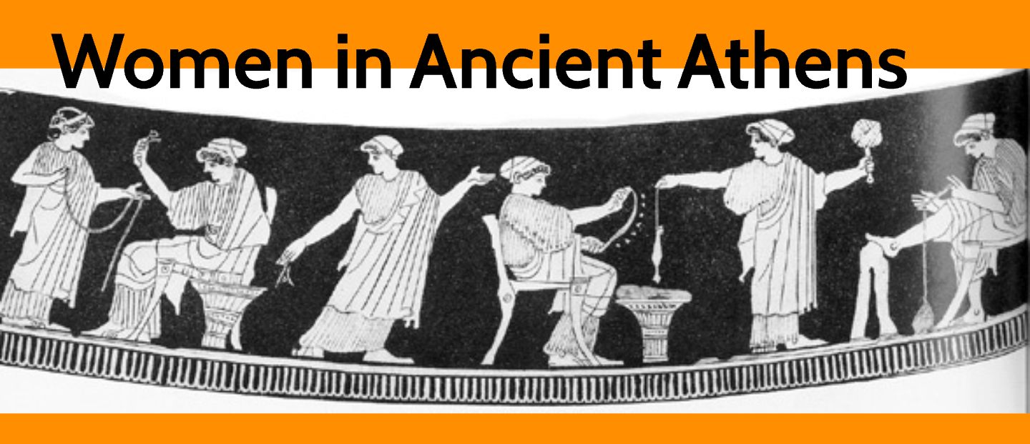

Slide 3
women
Greek women had virtually no political rights of any kind and were controlled by men at nearly every stage of their lives.
The most important duties for a city-dwelling woman were to bear children--preferably male--and to run the household.
Duties of a rural woman included some of the agricultural work: the harvesting of olives and fruit was their responsibility, as may have been the gathering of vegetables.

Slide 4
WOMEn
Girls learned in school or at home
They learned important household skills (spinning, weaving, sewing, cooking, & other household jobs
Girls spent most of their time in their house & only left to perform religious duties
Girls often got married in their teens, & often to man in their 30’s
The women’s father would choose her husband, and wouldn’t meet or know what he looks like until the day of the marriage

Slide 5
Women
Once married, all her property was owned by her husband – if they were to ever get divorced, all control and rights went over to her father or the nearest male relative
Women weren’t important but goddesses are very important
Women had very few rights & men have very little respect for all women
Jobs that a woman could participate in were – weddings, funerals, & regligious festivals
https://www.youtube.com/watch?v=GdA7FRDINp4

Slide 6
Slaves vs Women
Who was more important??

Slide 7
Slavery was a necessary institution in Athenian society. Slaves were the property of their owners and could be bought and sold at any time. They held no enforceable legal rights and had no citizenship rights.
Slaves were very common place in Athens; even poor families had one or two while wealthy families had 50 or more. Slaves were un-ransomed war prisoners, stolen as children from enemies, or traded in from other countries. Slaves were often treated fairly by their masters and could be freed.
Slaves had a variety of jobs, from working inside the home to working in the fields to acting as attendants – actually, some slaves became quite close to their owners and their families and were well-loved.

Slide 8
slaves
Greek slaves were more important!
Their masters needed slaves to do work for them
Some of the women slaves cooked and cleaned, so they were important for healthy living
Their jobs were more important because they farmed for the men
The prized slaves worked as tutors

Slide 9
slaves
Slaves didn’t usually live long because of the dangerous work
They couldn’t use their own names, but were assigned a name by their master
Bad slaves who were weak and old were sold for little
The healthy and young were sold for more
were thought of as property, not citizen
Lowest class in the Athenian society
Were allowed to participate in family rituals

